Slide 1
JSTL
Using HTML, JSP and JSTL, you need to create two files, add.html and add.jsp.
In add.html, create a form with 2 set of radio buttons, called gender and poll, 2 values for gender radio button are male and female, while for poll radio button, create 3 values: beautiful, average, and ugly.
In add.jsp, get the current counter for all table fields, and then increase the appropriate table field based on user selection by 1.

Slide 2
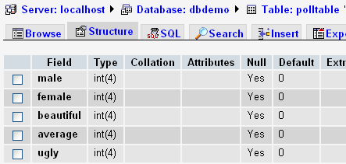
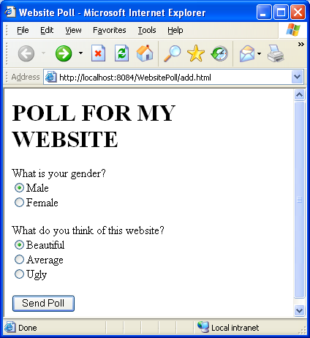

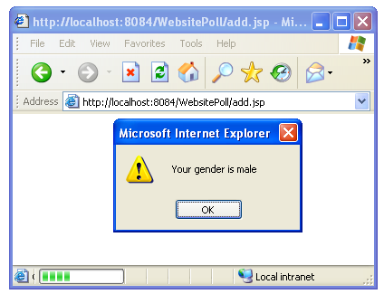

Slide 3
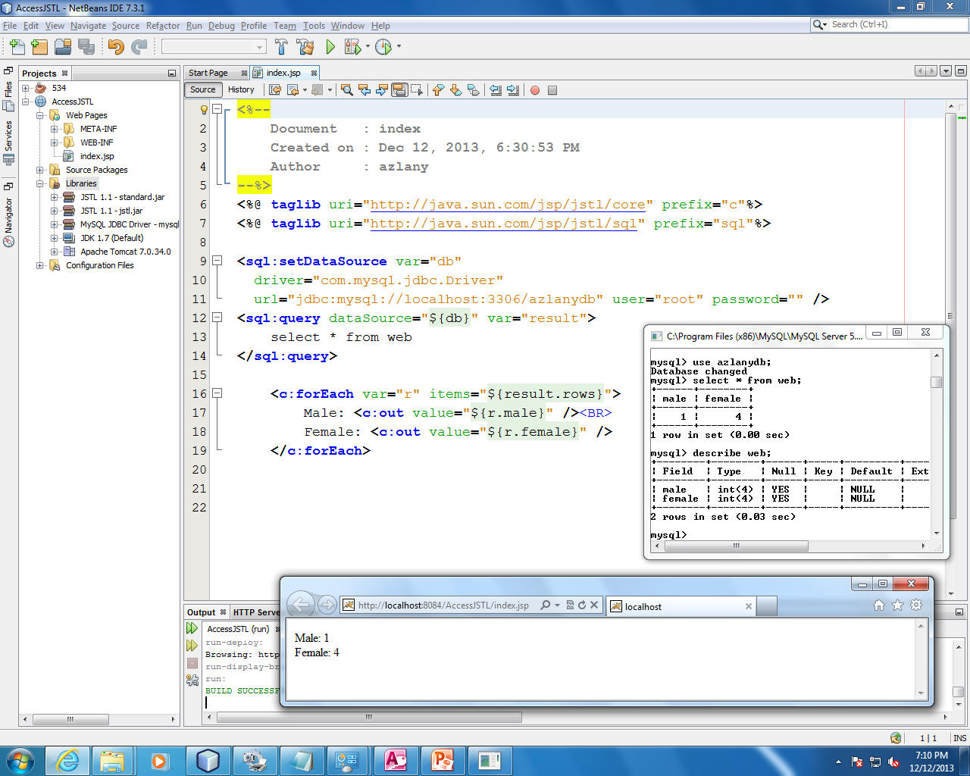
MySQL configuration

Slide 4
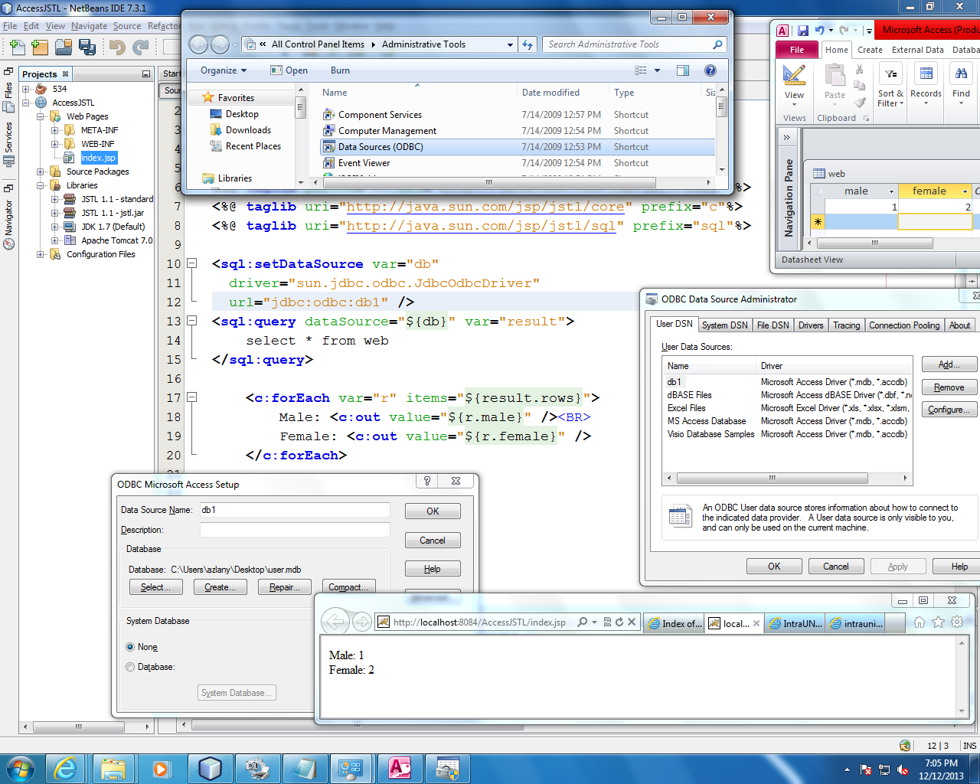
Ms Access configuration
MS Access configuration

Slide 5
Code sample
<script type=text/javascript>
alert(“hello”);
</script>
<input type=radio name=gender value=male>Male
<c:out value=“${param.gender}” />
<c:out value=“${gender}” />

Slide 6
Code sample
<c:if test="${not empty param.success}"> //do something </c:if>
<c:set var = "TR1" value="TR1"/>
<c:if test = "${class eq TR1}“>//process</c:if>
<option value="<c:out value='AAA'/>" >
<c:if test="${transaction eq 'AAA'}"> selected='selected'</c:if>
<c:out value='AAA'/></option>
<c:if test="${str == 'hello'}“>Both string are equal;</c:if>

Slide 7
Code sample
<sql:update dataSource=“${snapshot}”>
DELETE from employess WHERE Id = ‘?’ AND age = ‘?’
<sql:param value=“${empid}”>
<sql:param value=“${age}”>
</sql:update>

Slide 8
Step by step
NetBeans
Apache Tomcat
  Project - Import libraries – JSTL / MySQL
HTML – form
JSP
  display the param
  javascript
  query – view/get total from database
  check value using <c:if>
  increase value/vote by 1
  update database

